Slide 1
Nitrous oxide production
Weekly update meeting 02.10.23

Slide 2
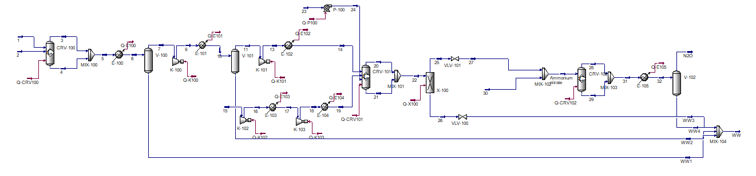
BAU flowsheet – best case

Slide 3
Ammonia is the major contributor to the economics
Fossil ammonia scenario (best)
Component | USD₂₀₁₉ kg⁻¹ N₂O | USD₂₀₂₂ kg⁻¹ N₂O
Oxygen | 0.183 | 0.246
Ammonia | 0.316 | 1.199
Electricity | 0.003 | 0.022
Cooling water | 0.003 | 0.004
CAPEX | 0.047 | 0.063
Total | 0.553 | 1.534
Wind ammonia scenario (best)
Component | USD₂₀₁₉ kg⁻¹ N₂O | USD₂₀₂₂ kg⁻¹ N₂O
Oxygen | 0.000 | 0.000
Ammonia | 1.134 | 1.170
Electricity | 0.003 | 0.022
Cooling water | 0.003 | 0.004
CAPEX | 0.047 | 0.063
Total | 1.187 | 1.258

Slide 4
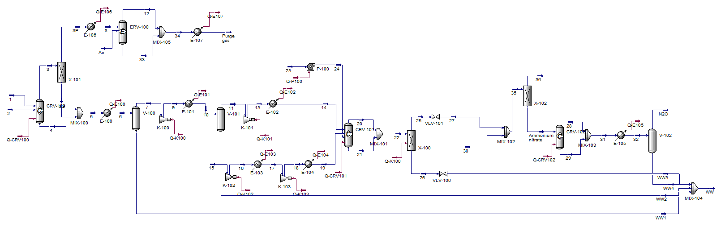
BAU flowsheet – actual case

Slide 5
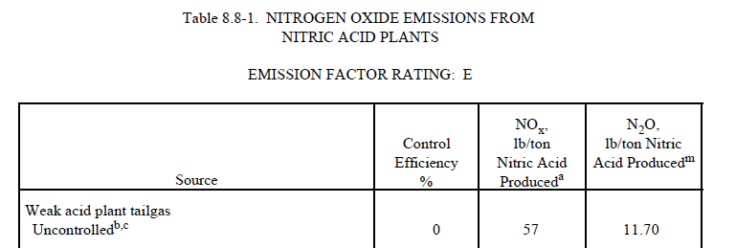
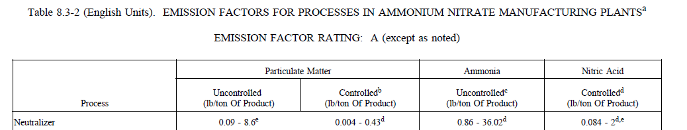
Emissions from literature

Slide 6
Actual economics
Fossil ammonia scenario (actual)
Component | USD₂₀₁₉ kg⁻¹ N₂O | USD₂₀₂₂ kg⁻¹ N₂O
Oxygen | 0.189 | 0.254
Ammonia | 0.328 | 1.245
Electricity | 0.003 | 0.021
Cooling water | 0.003 | 0.004
CAPEX | 0.048 | 0.065
Total | 0.572 | 1.589
Wind ammonia scenario (actual)
Component | USD₂₀₁₉ kg⁻¹ N₂O | USD₂₀₂₂ kg⁻¹ N₂O
Oxygen | 0.000 | 0.000
Ammonia | 1.177 | 1.214
Electricity | 0.003 | 0.021
Cooling water | 0.003 | 0.004
CAPEX | 0.048 | 0.065
Total | 1.231 | 1.304

Slide 7
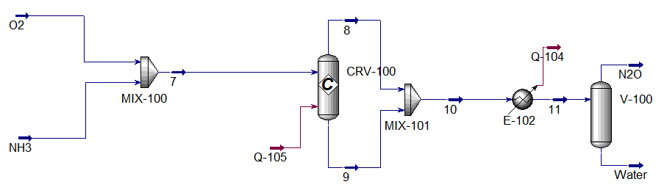
One step synthesis – 80%, 90%, or 100%

Slide 8
Economics of one step process
Fossil ammonia scenario 90% selectivity
Component | USD₂₀₁₉ kg⁻¹ N₂O | USD₂₀₂₂ kg⁻¹ N₂O
Oxygen | 0.196 | 0.263
Ammonia | 0.344 | 1.305
Electricity | 0.000 | 0.000
Cooling water | 0.002 | 0.002
CAPEX | 0.012 | 0.016
Total | 0.554 | 1.587
Wind ammonia scenario 90% selectivity
Component | USD₂₀₁₉ kg⁻¹ N₂O | USD₂₀₂₂ kg⁻¹ N₂O
Oxygen | 0.000 | 0.000
Ammonia | 1.234 | 1.273
Electricity | 0.000 | 0.000
Cooling water | 0.002 | 0.002
CAPEX | 0.012 | 0.016
Total | 1.248 | 1.292

Slide 9
Global warming potential per kg
New process
Name | Ammonia source | GWP [kg CO₂-eq kg⁻¹ N₂O]
80% selectivity | Fossil | 4.300
80% selectivity | Wind (green) | 2.693
90% selectivity | Fossil | 3.866
90% selectivity | Wind (green) | 2.437
100% selectivity | Fossil | 3.518
100% selectivity | Wind (green) | 2.232
BAU
Name | Ammonia source | GWP [kg CO₂-eq kg⁻¹ N₂O]
BAU best | Fossil | 3.647
BAU best | Wind (green) | 2.335
BAU actual | Fossil | 5.822
BAU actual | Wind (green) | 4.460

Slide 10
Next steps?
Safety
Javier meeting

